Slide 1
Module 12: Well-Architected Pillar 4 - Performance Efficiency
Notes:
Welcome to Module 12, where you will explore the Well-Architected Framework, Pillar 4, Performance Efficiency.
This module provides in-depth insight into the Performance Efficiency pillar of the Well-Architected Framework. While many best practices are discussed, this module focuses on how to tune or offload components of your system to improve system performance. Tools and services to provide reliability focused content include:
• Amazon Elastic Block Store, or Amazon EBS
• Amazon Simple Storage Service, or Amazon S3
• Amazon Glacier
• Amazon Relational Database Service, or Amazon RDS
• Amazon DynamoDB
• Amazon CloudFront
• AWS Auto Scaling
• Amazon ElastiCache, and
• Amazon Kinesis Streams

Slide 2
What’s in This Module
Part 1: Principles of the Performance Efficiency Pillar
Part 2: Infrastructure Efficiency Improvements
Part 3: Exercise: Improve the Architecture
Part 4: Performance Efficiency Pillar Questions and Best Practices
Notes:
This module is divided into four parts.
In part 1, you will learn about the principles of the Performance Efficiency pillar.
In part 2, you will learn how to make your infrastructure more efficient.
In part 3, you will complete an exercise to improve the architecture.
And finally, in part 4, you will review questions and best practices related to the Performance Efficiency pillar.

Slide 3
Module Objectives
Upon completion of this module, you will be able to:
Select compute, storage, database, and network resources to improve your architecture’s performance.
Identify design principles that can help you achieve performance efficiency.
Evaluate the most important performance metrics for your applications.
Notes:
After you complete this module, you will be able to:
• Select compute, storage, database, and networking resources to improve your architecture’s performance.
• Identify design principles that can help you achieve performance efficiency.
• And, evaluate the most important performance metrics for your applications.
The recommendations and best practices presented in this module are based on extensive experience and knowledge gathered by the AWS team of experts through their work with numerous customers. These are not hard and fast rules, unless specified as a rule. The objective is to help you evaluate the options for structuring systems and know which questions to ask during a design review, so you can ensure decisions are justified by cost, security, governance, or other driver.

Slide 4
Principles of the Performance Efficiency Pillar
Notes:
To begin, let’s review the principles of the Performance Efficiency pillar. In the cloud, several principles can help you achieve performance efficiency. Our goal is to help you get the most out of your architecture.

Slide 5

Pillar 4: Performance Efficiency
The ability to use computing resources efficiently to meet system requirements and to maintain that efficiency as demand changes and technologies evolve.
Selection
Review
Monitoring
Tradeoffs
Notes:
Performance efficiency is the ability to use computing resources efficiently to meet system requirements, and to maintain that efficiency as demand changes and technologies evolve.
This requires you to:
• Select the right resource types for computing, storage, databases, and networking.
• Review your selections using benchmarking and load tests to validate your system, especially as new services and features are launched.
• Use monitoring to know when your performance degrades, so you can take action before it impacts customers.
• And make architectural tradeoffs to maximize performance efficiency. For example, you might use a cache to improve performance and reduce the load on your database.

Slide 6
Design Principles
Democratize advanced technologies
Go global in minutes
Use serverless architectures
Experiment more often
Achieve mechanical sympathy
Notes:
A number of design principles can help you achieve performance efficiency in the cloud. Let’s look at a few key principles.
First, advanced technologies can be democratized. Technologies that are difficult to implement can become easier to consume by pushing the knowledge and complexity into the cloud vendor’s domain. Rather than having your IT team learn how to host and run a new technology, they can consume it as a service. For example, NoSQL databases, video transcoding, and machine learning are all technologies that require expertise that is not evenly dispersed across the technical community. In the cloud, these technologies become services that your team can consume while focusing on product development rather than resource provisioning and management.
Next, in the cloud, you can go global in minutes. You can easily deploy your system in multiple regions around the world with just a few clicks. This generally allows you to provide lower latency and a better experience for your customers at minimal cost.
The cloud also enables you to use serverless architectures, such as AWS Lambda, which removes the need for you to run and maintain servers to process traditional compute activities. For example, storage services can act as static websites, removing the need for web servers, and event services can host code for you. This removes the operational burden of managing servers and can lower transactional costs, because the serverless managed services operate at cloud scale.
With cloud technology, you can experiment more often. With virtual and automatable resources, you can quickly carry out comparative testing using different types of instances, storage, and configurations.
Finally, you can achieve mechanical sympathy. In the cloud, you can use the technology approach that aligns best to what you are trying to achieve. For example, if you are accustomed to using a SQL database solution, you might experiment and discover NoSQL is a better solution. You can consider data access patterns when selecting database and storage approaches.

Slide 7










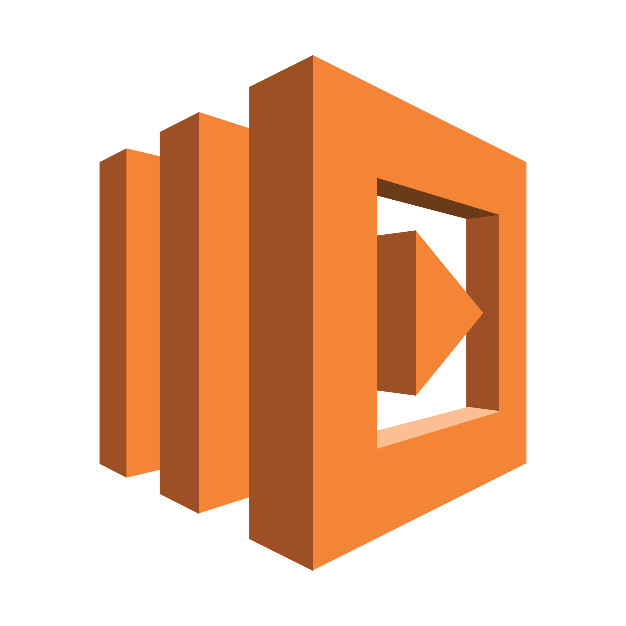



Key Services for Performance Efficiency
Areas | Key Services
Selection (Compute, Storage, Database, Network)
Review
Monitoring
Tradeoffs
Amazon
CloudWatch
Auto Scaling
Amazon S3
Amazon RDS
Amazon
DynamoDB
Amazon
Route 53
AWS Direct Connect
Amazon EBS
Amazon VPC
AWS Blog and What’s New
Amazon
CloudWatch
AWS Lambda
Amazon
CloudFront
Amazon
ElastiCache
AWS
Snowball
Amazon RDS
Notes:
One key AWS service for performance efficiency is Amazon CloudWatch, which monitors resources and systems. CloudWatch provides visibility into your architecture’s overall performance and operational health.
As mentioned earlier, performance efficiency can be divided into four areas—selection, review, monitoring, and tradeoffs. Specific AWS services are important in each of the four areas, as you can see here.
The Selection area encompasses compute, storage, database, and network services. For compute, Auto Scaling is key to ensuring you have enough instances to meet demand and maintain responsiveness. For storage, Amazon EBS provides a wide range of storage options—such as solid state drives, or SSDs—and provisioned input-output operations per second, which allows you to optimize for your use case. Amazon S3 provides serverless content delivery, and Amazon S3 transfer acceleration enables fast, easy, and secure transfers of files over long distances. For databases, Amazon RDS provides a wide range of database features—such as provisioned IOPS and read replicas—that allow you to optimize for your use case. Amazon DynamoDB provides single-digit millisecond latency at any scale. For network, Amazon Route 53 provides latency-based routing. Amazon VPC endpoints and AWS Direct Connect can reduce network distance and jitter.
For the Review area, the AWS Blog and the What’s New section on the AWS website are resources for learning about newly launched features and services.
For Monitoring services, Amazon CloudWatch provides metrics, alarms, and notifications you can integrate with your existing monitoring solution. You can also use CloudWatch with AWS Lambda to trigger actions.
For tradeoffs, Amazon ElastiCache, Amazon CloudFront, and AWS Snowball are services that allow you to improve performance. In addition, read replicas in Amazon RDS can help you scale read-heavy workloads.

Slide 8
Infrastructure Efficiency Improvements
Notes:
In this section, you will explore ways to make your infrastructure more efficient.

Slide 9
Optimal EC2 Instance Size
Evaluate the most important performance metrics for your application, and choose the appropriate instance family and instance type.
Avoid overprovisioning and underprovisioning.
Change instance types and sizes as your needs change.
Analyze if your application can scale across multiple EC2 instances. Design applications that are resilient to reboot and relaunch to allow for scaling horizontally, instead of vertically, where possible.
Notes:
When choosing the right EC2 instance size:
• Evaluate the most important performance metrics for your application, and choose the appropriate instance family and instance type.
• Avoid overprovisioning and underprovisioning.
• Change instance types and sizes as your needs change.
• And analyze if your application can scale across multiple EC2 instances. Design applications that are resilient to reboot and relaunch, to allow for scaling horizontally, instead of vertically, where possible.

Slide 10
Storage Comparison
 | Instance Store | Amazon EBS | Amazon S3 | Amazon Glacier
Average latency | ms | ms | ms, sec, min (~ size) | min, hrs
Data volume | 4 GB – 48 TB | 1 GiB – 16 TiB | No limit | No limit
Item size | Block storage | Block storage | 5 TB max | 40 TB max
Request rate | Very High | Very High | Low– Very High (no limit) | Very Low (no limit)
Cost/GB per month | Amazon EC2 instance cost | ¢¢ | ¢ | ¢
Durability | Low | High | Very High | Very High
Hot
Cold
Notes:
This chart compares storage types, showing their average latency, data volume, item size, average request rate, costs per month, and durability.
Instance store, which is not permanent, is where you can store cached information that your system needs very quickly, but have a copy stored somewhere else, and how it compares to Amazon EBS, Amazon S3, and Amazon Glacier.

Slide 11
Database Comparison
 | DynamoDB | Amazon RDS | Amazon Redshift
Average latency | ms | ms, sec | sec, min
Data volume | No limit | 5 GB – 64 TB max (Max varies depending on engine) | 1.6 PB max
Item size | KB (400 KB max) | KB (~rowsize) | KB (64 K max)
Request rate | Very High | High | Low
Cost/GB per month | ¢¢ | ¢¢ | ¢
Durability | Very High | High | High
Hot
Cold
Notes:
This comparison chart shows the primary AWS database services, including DynamoDB, which is NoSQL, Amazon Relational Database Service, or RDS, and Amazon Redshift, which is more of a database warehouse solution. Here, you can compare the average latency, data volume, item size, request rate, cost per month, and durability.

Slide 12

Amazon ElastiCache
Amazon ElastiCache is a web service that simplifies deploying, operating, and scaling an in-memory cache in the cloud. ElastiCache:
Improves performance of web applications by allowing you to retrieve information from fast, managed, in-memory caches, instead of relying entirely on slower disk-based databases.
Simplifies and offloads the management, monitoring, and operation of in-memory cache environments.
Supports Memcached and Redis open-source in-memory caching engines.
Notes:
Amazon ElastiCache is a web service that simplifies deploying, operating, and scaling an in-memory cache in the cloud.
It improves the performance of web applications by allowing you to retrieve information from fast, managed, in-memory caches, instead of relying entirely on slower disk-based databases.
Amazon ElastiCache can be used to significantly improve latency and throughput for many read-heavy application workloads or compute-intensive workloads by allowing you to store the objects that are often read in cache.
It simplifies and offloads the management, monitoring, and operation of in-memory cache environments, enabling you to focus on the differentiating parts of your applications. In some cases, ElastiCache may be a better fit than a read replica if there’s too much stress on your read replica or you need to offload requests from your main database.
Amazon ElastiCache supports two open-source, in-memory caching engines—Memcached and Redis.
In addition, ElastiCache provides ease of management via the AWS Management Console.
It is also compatible with the specific engine protocol. This means most of the client libraries will work with the respective engines they were built for, with no additional changes or tweaking required.
Amazon CloudWatch provides detailed monitoring statistics for the engine nodes at no extra cost.
And you pay only for the resources you consume based on node hours used.
To learn more about ElastiCache, select the link.
http://aws.amazon.com/elasticache/

Slide 13
Amazon Kinesis Streams
Enables you to build custom applications that process or analyze streaming data.
Can continuously capture and store terabytes of data per hour from hundreds of thousands of sources, such as:
Website clickstreams
Financial transactions
Social media feeds
IT logs
Use Amazon Kinesis Client Library (KCL) to build applications, stream data to power real-time dashboards, generate alerts, and so forth.
Notes:
Amazon Kinesis Data Streams enables you to build custom applications that process or analyze streaming data for specialized needs. You can configure hundreds of thousands of data producers to continuously put data into an Amazon Kinesis stream, including data from website clickstreams, application logs, and social media feeds. In less than a second, large amounts of data can be available for your Amazon Kinesis applications to read and process from the stream.
As you can see here, Amazon Kinesis can continuously capture and store terabytes of data per hour from hundreds of thousands of sources, such as:
Website clickstreams
Financial transactions
Social media feeds
And IT logs
With Amazon Kinesis Client Library, or KCL, you can build Amazon Kinesis applications, and use streaming data to power real-time dashboards, generate alerts, implement dynamic pricing and advertising, and more. You can also emit data from Amazon Kinesis to other AWS services, such as Amazon Simple Storage Service, or Amazon S3, Amazon Redshift, Amazon EMR, and AWS Lambda.
Select the link to learn more.
https://aws.amazon.com/kinesis/streams/

Slide 14
Exercise: Improve the Architecture
Notes:
Next, you will review ways to improve an architecture’s performance efficiency.

Slide 15
Performance Efficiency
In this exercise, you are a small business owner. Your website frequently experiences intermittent page load issues, and users often report significant load times. To help resolve this issue, you will:
Review the architecture and ask questions to identify where improvements can be made to increase the system’s performance efficiency.
Consider performance efficiency enhancements in accordance with the Well-Architected Performance Efficiency pillar.
Notes:
In this scenario, you are a small business owner. Your website frequently experiences intermittent page load issues, and users often report significant load times. To help resolve this issue, you will:
• Review the architecture and ask questions to identify where improvements can be made to increase the system’s performance efficiency.
• Consider performance efficiency enhancements in accordance with the Well-Architected Performance Efficiency pillar.

Slide 16






Performance Exercise
IGW
NAT
(t2.micro)
Web Server
Public Subnet
RDS Master
App Server
App Server
Private Subnet
Availability Zone 1
Notes:
Review the architecture and identify where improvements can be made to increase the system’s performance efficiency.
Consider performance efficiency enhancements in accordance with the Well-Architected Performance Efficiency pillar.

Slide 17



Performance Exercise
IGW
NAT Gateway
Web Server
Public Subnet
DynamoDB
Session Info
RDS Master
ElastiCache
App Server
App Server
Private Subnet
Amazon S3
Availability Zone 1
Notes:
Now, consider the following:
• Is your NAT (t2.micro) the bottleneck? Consider a bigger EC2 instance or use a managed NAT.
• Should you consider Elastic Load Balancing and Auto Scaling groups?
• By offloading static content to S3, can you relieve the processing burden from the EC2 instances?
• Are your compute resources the right combination of CPU and memory?
• Is the page load issue due to throughput or database latency? Should you consider provisioned IOPS for your RDS instance to get consistent performance? Should you consider offloading some of the database reads to a dedicated read-replica?
• What’s the geographic location and latency from the region to the user? Have you considered using a content distribution network, like CloudFront, to bring the content closer to your users?

Slide 18
Additional Resources
Videos
Performance Channel
Performance Benchmarking on AWS
Documentation
Amazon S3 Performance Optimization Documentation
Amazon EBS Volume Performance Documentation
Notes:
AWS offers many resources to help with performance efficiency improvements. Here are a few additional resources.
Select each link to learn more.

Slide 19
Performance Efficiency Pillar Questions and Best Practices
Notes:
Before wrapping up this module, let’s review some performance efficiency questions and best practices.

Slide 20


Performance Question
How do you select the appropriate instance types, storage solutions, database solutions, and proximity and caching solutions for your system?
Best practices
Select solutions based on:
Predicted resource needs
Required internal governance standards
Cost or budget
Benchmarking results
Load testing results
Guidance from AWS or from a member of the AWS Partner Network (APN)
Notes:
How do you select the appropriate instance types, storage solutions, database solutions, and proximity and caching solutions for your system?
Take a moment to review the best practices.

Slide 21
Performance Question
How do you ensure that you continue to have the most appropriate instance types, storage solutions, database solutions, and proximity and caching solutions as new services and features are launched?
Best practices
Review cyclically, and reselect new services and features based on predicted resource needs.
Benchmark and load test after each new service or feature is released, and use that information to make the best selection based on a calculation of performance or cost.
Notes:
How do you ensure that you continue to have the most appropriate instance types, storage solutions, database solutions, and proximity and caching solutions as new services and features are launched?
Take a moment to review the best practices.

Slide 22
Performance Question
How do you monitor your instances, storage solutions, databases, and proximity and caching solutions to ensure they are performing as expected?
Best practices
Monitor instances with:
Amazon CloudWatch
Third-party tools
Perform a periodic review of your monitoring dashboards.
Use alarm-based notifications to automatically alert you if metrics are out of safe bounds.
Use trigger-based actions to cause automated actions to remediate or escalate issues.
Notes:
How do you monitor your instances, storage solutions, databases, and proximity and caching solutions to ensure they are performing as expected?
Take a moment to review the best practices.

Slide 23
Performance Question
How do you ensure that the capacity and throughput of your instances, storage solutions, databases and proximity and caching solutions match demand?
Best practices
React based on manually reviewing metrics.
Plan future capacity and throughput based on metrics and/or planned events.
Automate against metrics.
Perform a periodic review of cache usage and demand over time.
Monitor usage and demand over time.
Use the following for automatic management:
Scripting and tools
Auto Scaling
Notes:
How do you ensure that the capacity and throughput of your instances, storage solutions, databases, and proximity and caching solutions match demand?
Take a moment to review the best practices.

Slide 24

Review
Reviewed compute, storage, database, and network resources to improve your architecture’s performance efficiency.
Identified design principles that can help your system achieve performance efficiency.
Evaluated the most important performance metrics for your applications.
Complete:
Knowledge Assessment
Notes:
In this module, you:
• Reviewed compute, storage, database, and network resources to improve your architecture’s performance efficiency.
• Identified design principles that can help your system achieve performance efficiency.
• And evaluated the most important performance efficiency metrics for your applications.
In addition, you reviewed an example architecture’s performance efficiency and discovered best practices.
To finish this module, please complete the lab and corresponding knowledge assessment.
24

Slide 25
Up Next: Well-Architected Framework Pillar 5 - Cost
Notes:
In the next module, you will explore the Well-Architected Framework, Pillar 5, which focuses on Cost.

Slide 26
Thanks for participating!
© 2018 Amazon Web Services, Inc. or its affiliates. All rights reserved. This work may not be reproduced or redistributed, in whole or in part, without prior written permission from Amazon Web Services, Inc. Commercial copying, lending, or selling is prohibited. Corrections or feedback on the course, please email us at: aws-course-feedback@amazon.com. For all other questions, contact us at: https://aws.amazon.com/contact-us/aws-training/. All trademarks are the property of their owners.
Notes:
Thanks for participating!

